Slide 1
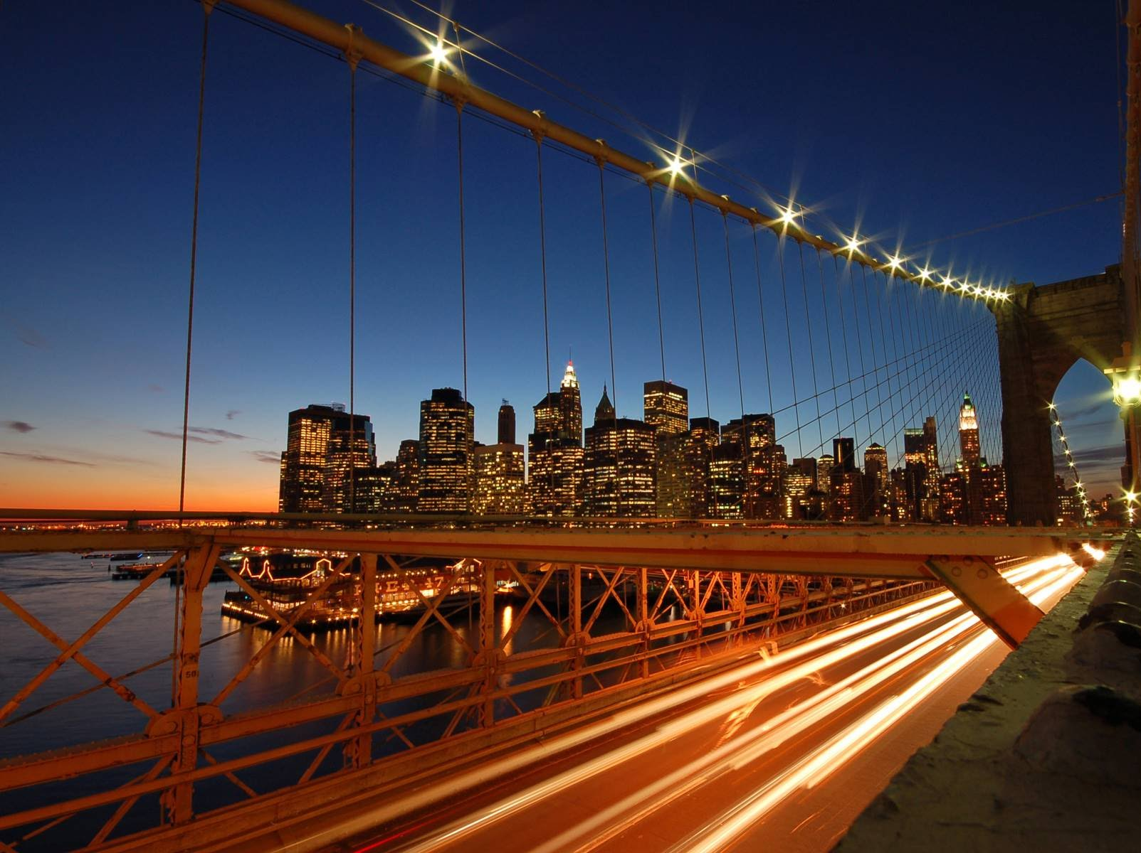
BES165 ► Infrastructure
Nuke Energy NSG, HELP-2016
Postal, Telecom, Mass.Comm (YB)
Kelkar-PPP
Rail Budget CAP-2016
Urban Infra-Bills.
Paris Summit Clean Energy

Slide 2
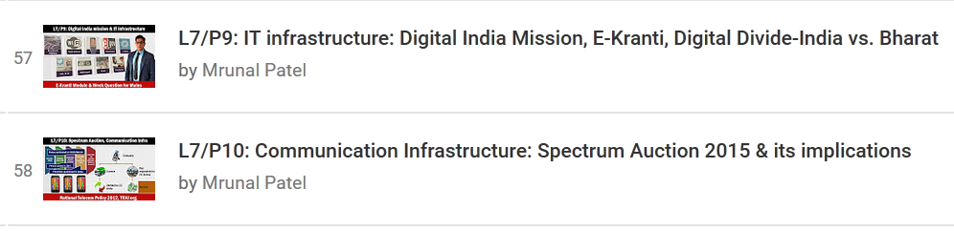
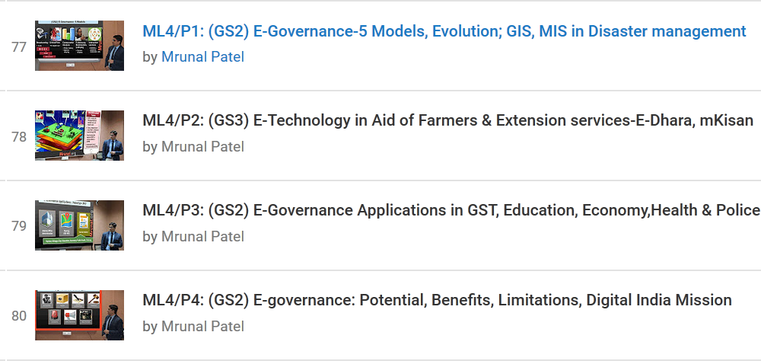

For MAINS

Slide 3
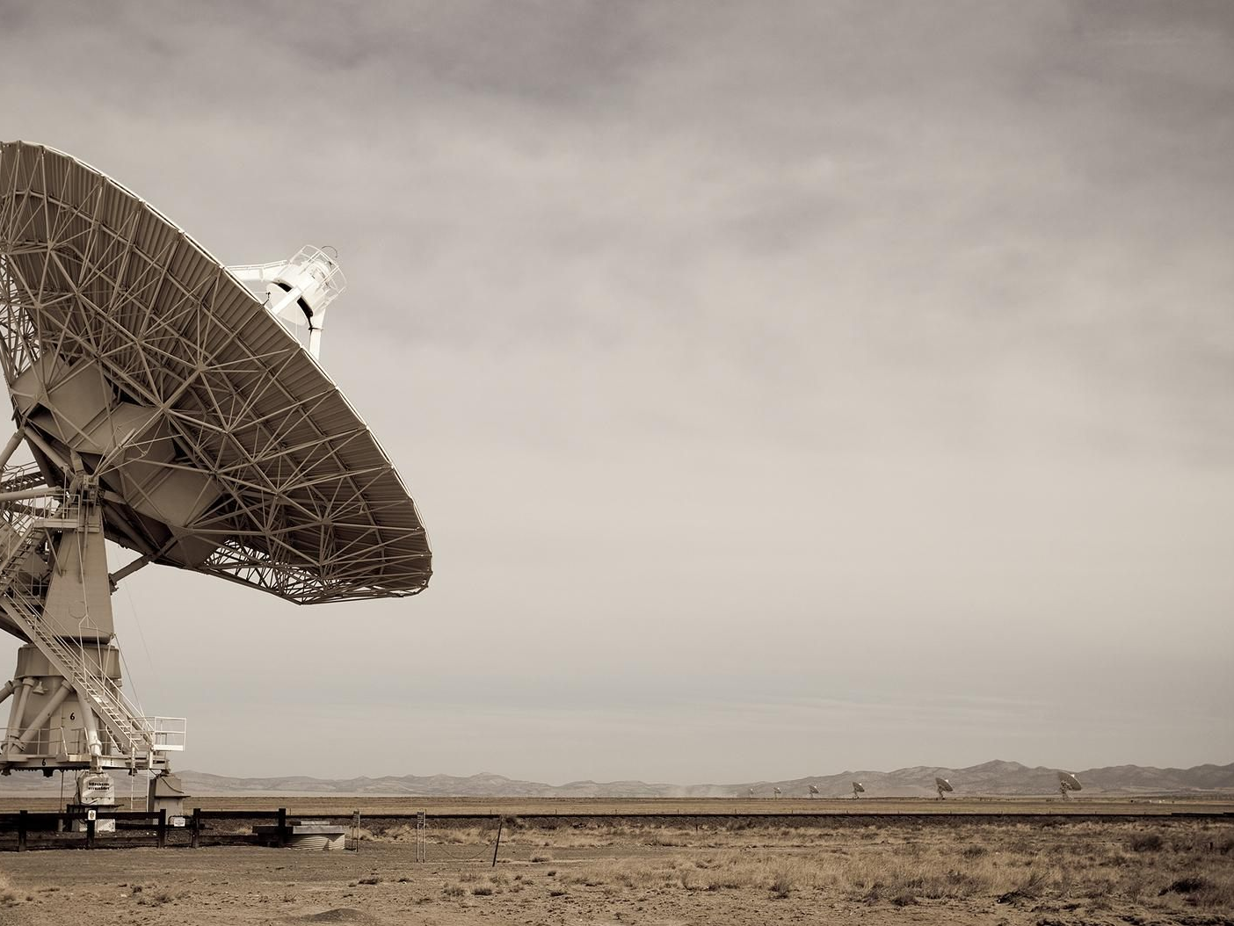
BES165 Infrastructure ► Communication
Radio (Sci-Tech)
Telecom (YB)
Post office (History & Culture)
Mass Comm. (YB)

Slide 4
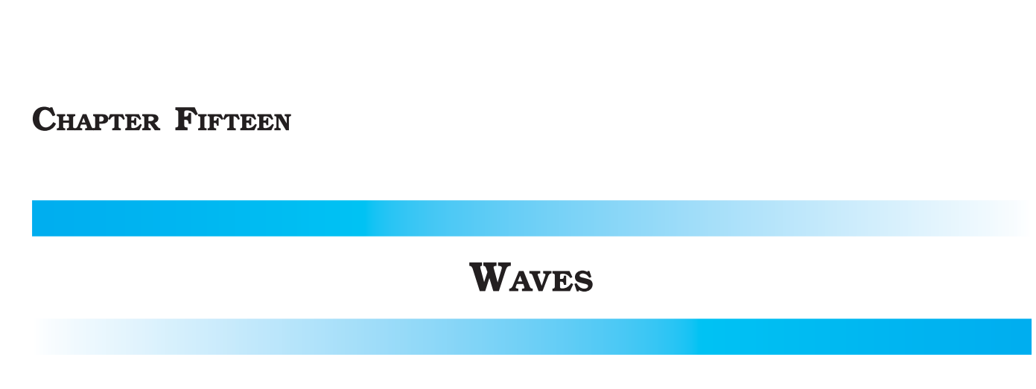
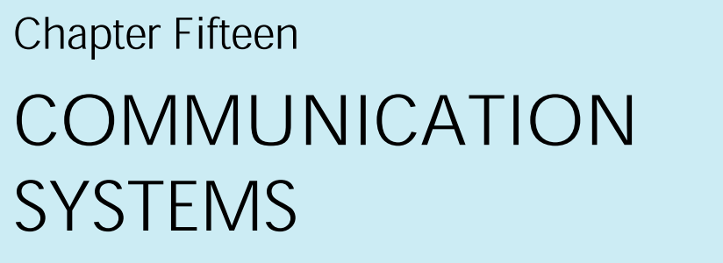
NCERT Class11
NCERT Class12

Slide 5
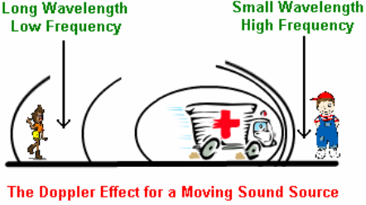
NCERT Class-11: Doppler, the Austrian scientist
Change in pitch (/Freq) with motion from stationary or moving object.
Observed in
Soundwave
Lightwave
Electromagnetic waves

Slide 6
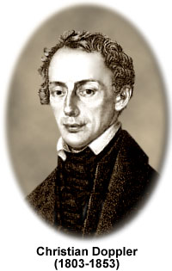
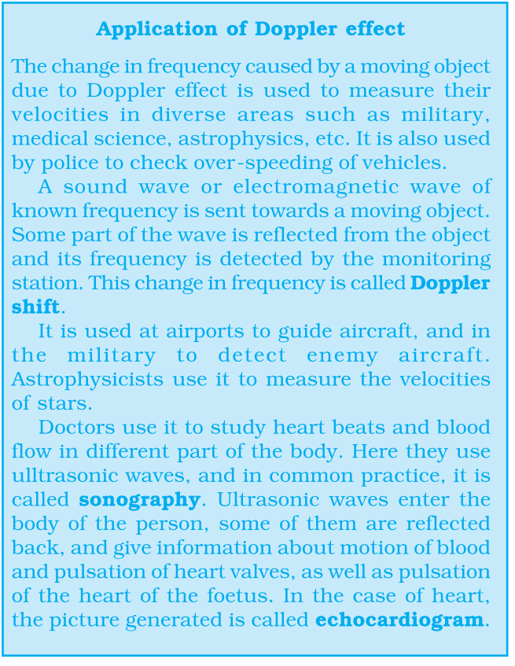
Use of Doppler
Applications
Land & Space
Railway wheel/track inspection
Police: overspeeding vehicles
velocity of missile, aircraft, spacecraft, STAR
Ocean
Detect submarine, fishess
Health
Ultrasound waves ► organ ►reflect ►Sonography.
Heartbeat picture-> Echo-cardiogram.
Motion of blood

Slide 7


Lightwaves also show Doppler effect
Hubble found this
Blue-shift
Star moving towards earth.
Red-shift
Star moving Away from earth.

Slide 8
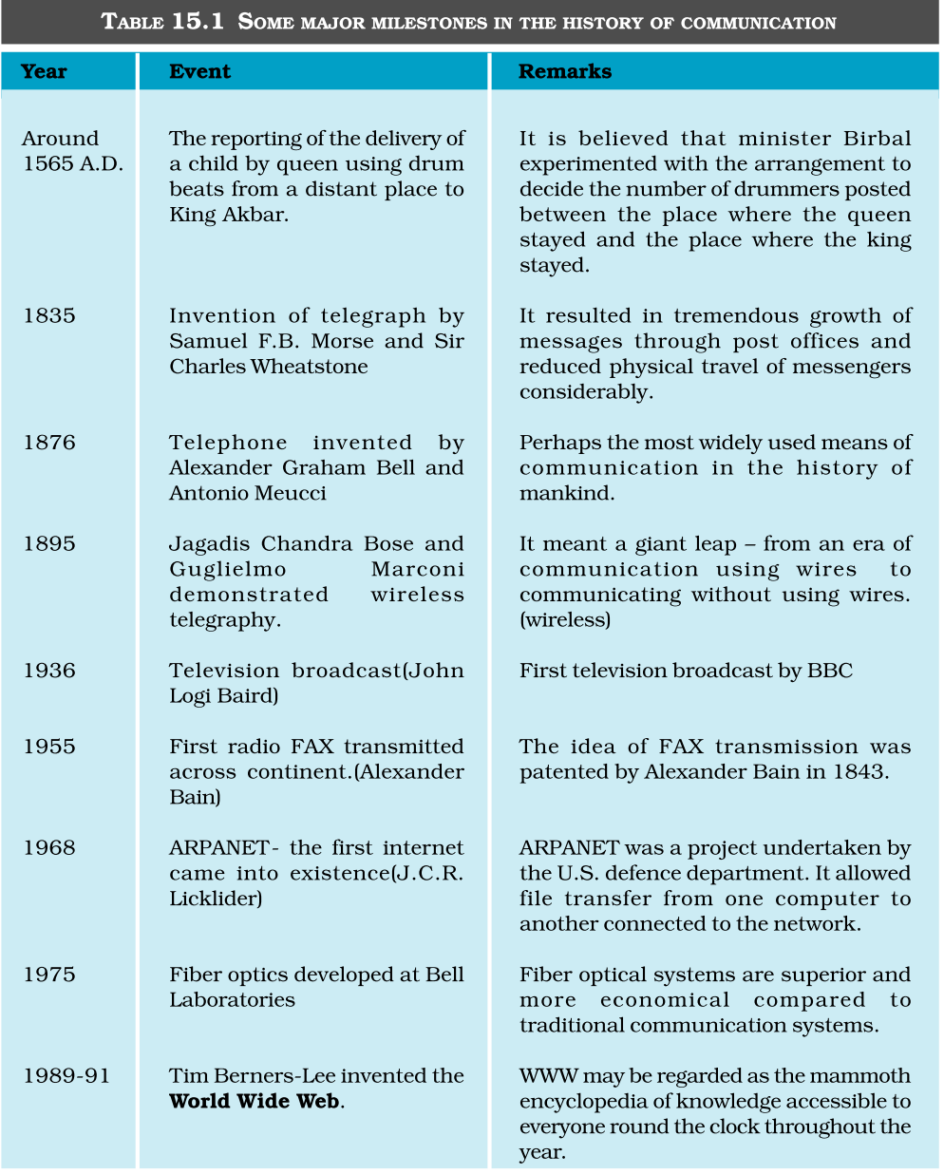
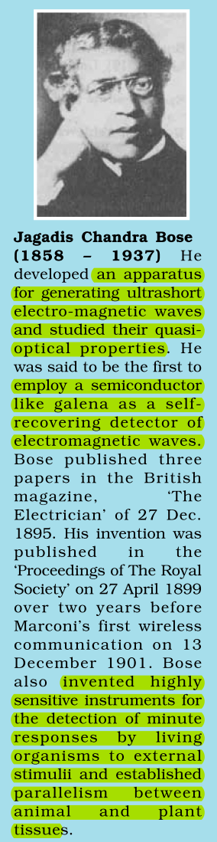
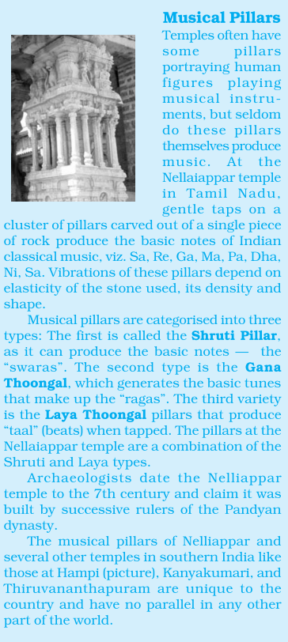

Slide 9

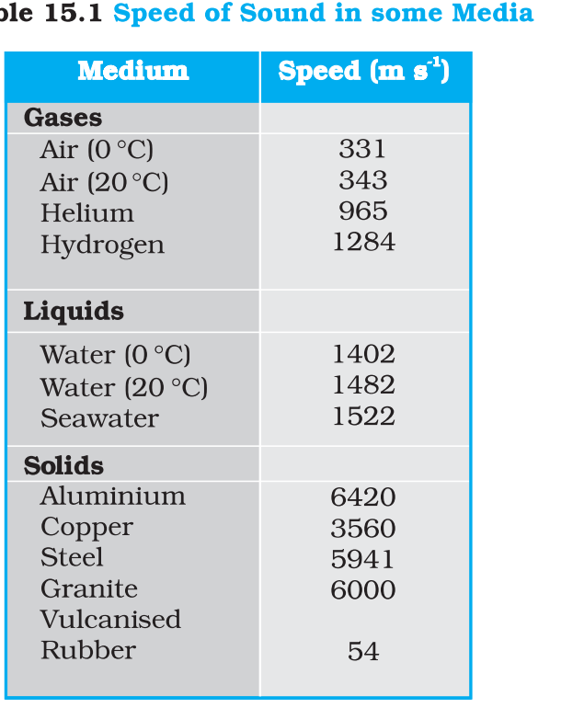
Density increase, Sound speed increase

Slide 10
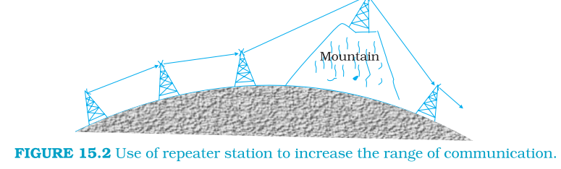
NCERT Class12: Communication ► Radio
Towers and satellites are “repeaters”
Repeater = transmit + amplify
Attenuation = signal dim through medium
Solution= Amplification (DC Amplifier)

Slide 11
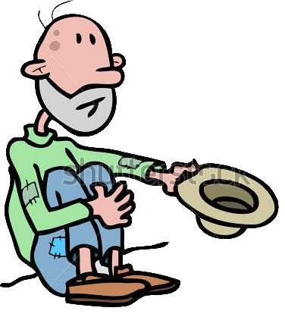
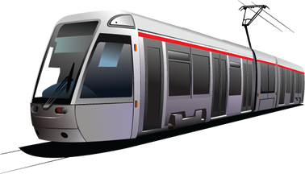
Radio: AM, FM, PM
Low freq. msg can’t travel long
Modulation
Amplitude Modulated (AM) waves (cheaper, preferred for long distance comm.)
Frequency Modulated (FM) (less interference)
Phase Modulated (PM)
superimpose it on high frequency “carrier” wave

Slide 12
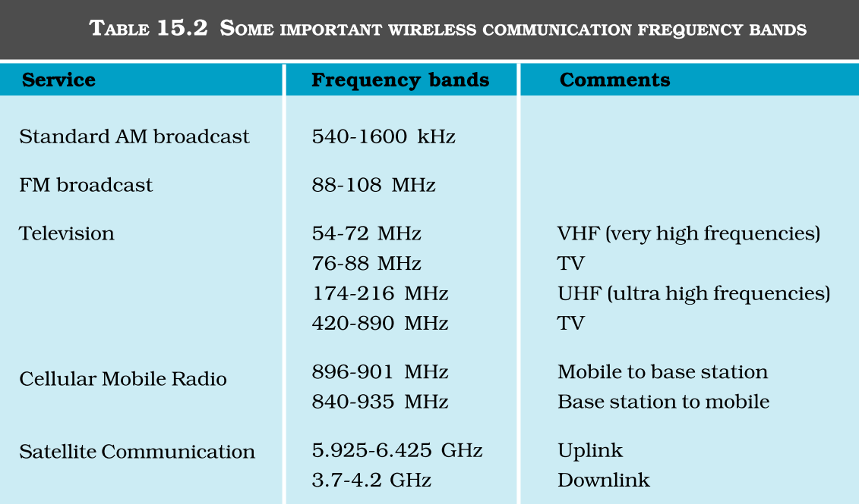
NCERT Class-12 Ch. 15 Comm.System
Self study: L7/P10: Communication Infrastructure: Spectrum Auction 2015 & its implications

Slide 13

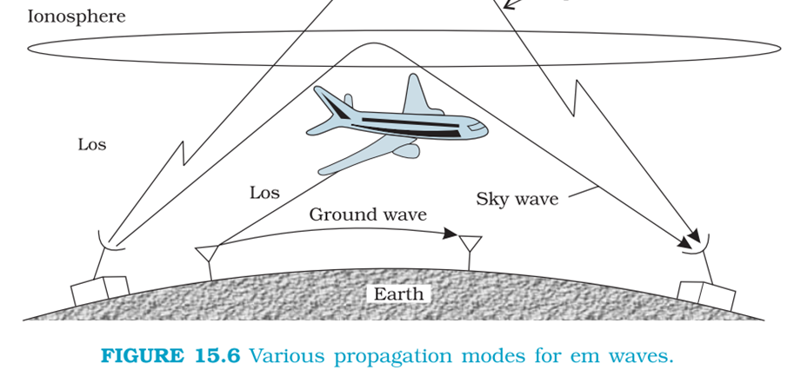
NCERT Class-12 Ch. 15 Comm.System
>~30Mhz escape (FM, TV, mobile)
~30Mhz Reflect back from ionosphere.
AM Radio
Upto 400km
Electromagnetic waves: ground, sky, space

Slide 14

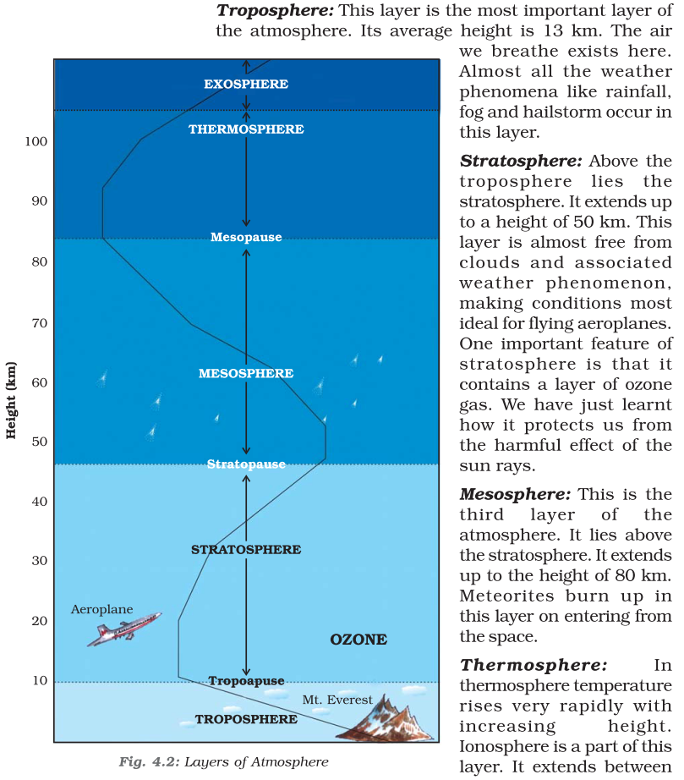
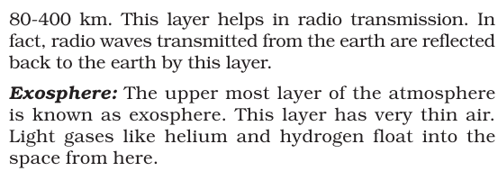
NCERT Class 7
Ch.04
नही पढ़ा है तो पढ़ लेना

Slide 15
BES165 Infrastructure ► Communication
Radio (Sci-Tech)
Telecom (YB)
Post office (History & Culture)
Mass Comm. (YB)

Slide 16

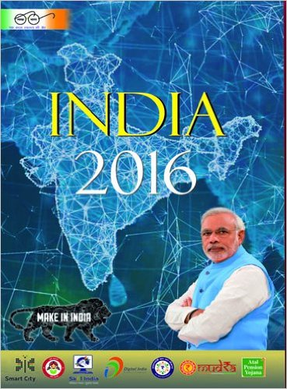

Prasar Bharati Corporation (act 1990)
Akashvani (AIR till 1957)
Motto: Bahujan Hitaay, Bahujan Sukhaay
Entertainment: Vividh Bharati, FM Rainbow, FM Gold,
National: Mann Ki Baat; Regional; Local
Doordarshan (1959)
Vaartaavali: 1st Sanskrit News Magazine
INSAT-4B to deliver in 38 countries

Slide 17
News & Movies
News Agencies
Under Min I&B
Registrar of Newspapers (Attached office)
PTI- non-profit society, "BHASHA"-newswire
United News India: Company, "UNIVARTA"-newswire
Press Information Bureau
Journalists' welfare schemes
I&B Publication
Yojana, Kurukshetra, India-reference manual.
Bal Bharti: Children's magazine in Hindi
Ajkal: magazine on Indian culture and literature.
Movies
International film festival of India, Goa:= Min I&B+ Goa Gov.
Dada Saheb Phalke, National Film Award
Film and Television Institute of India (FTII), Pune: under societies reg. act.

Slide 18
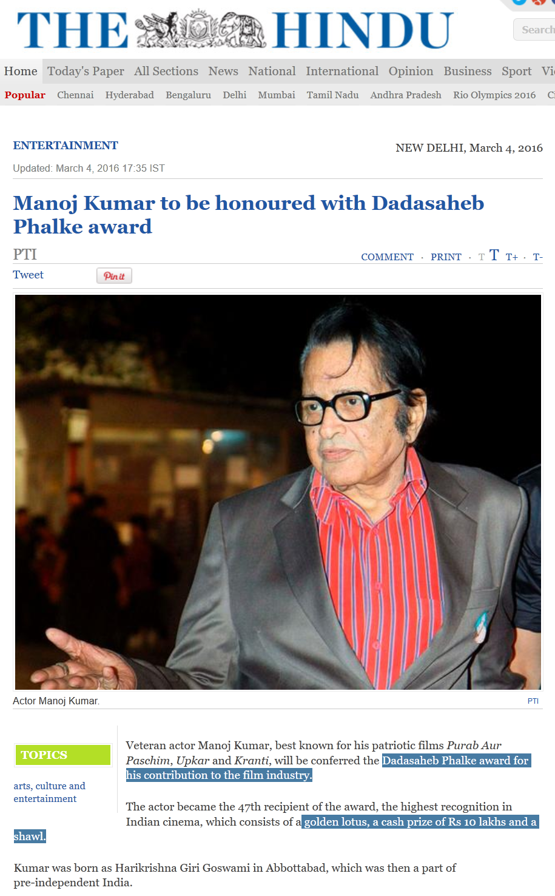
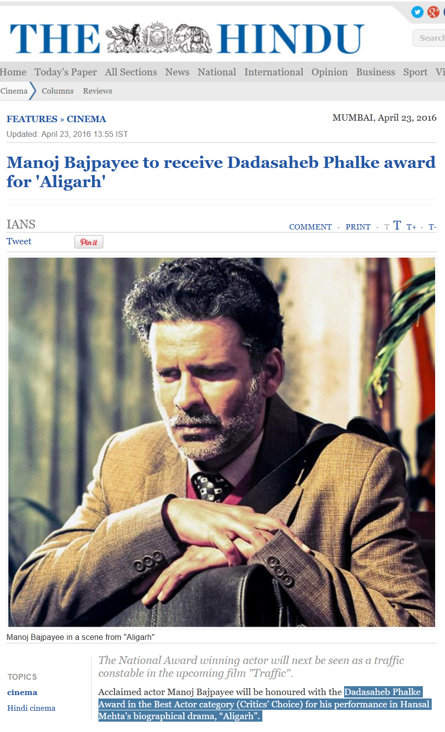


Given by I&B+ President , hence imp. For exam
This is given by “foundation”, not imp for exam
Notes:
http://www.huffingtonpost.in/2016/05/05/attention-there-is-only-one-dadasaheb-phalke-award-thats-wor/

Slide 19
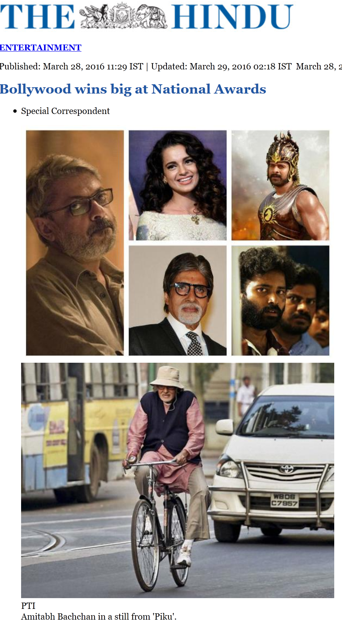
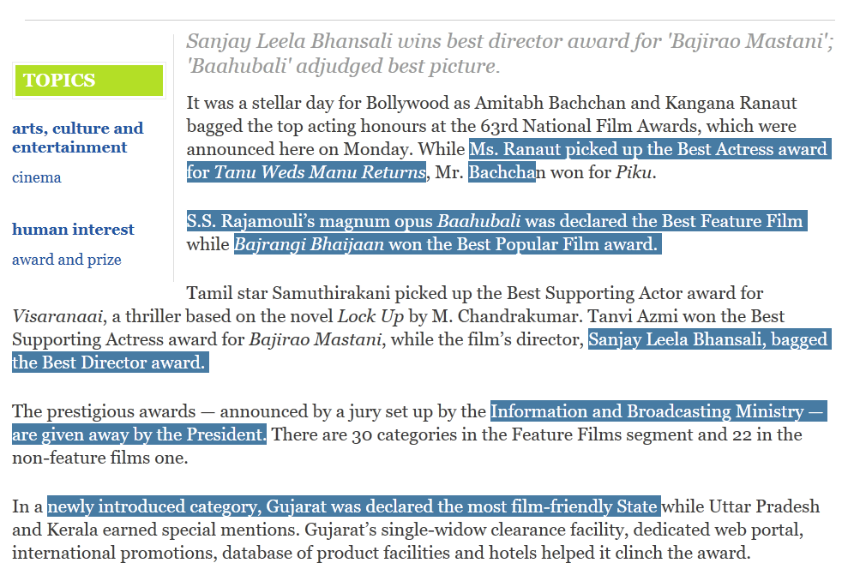

Slide 20
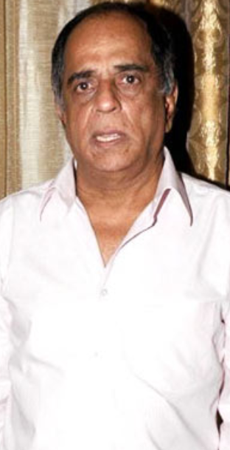
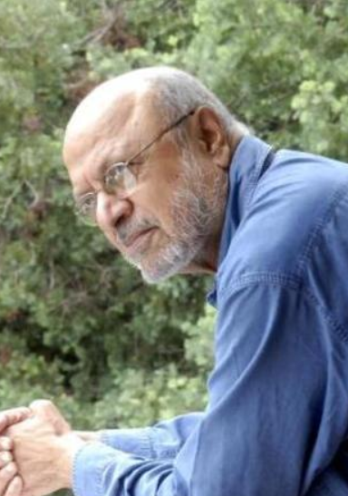
Cinema Regulation?
Indian Cinematography Act, 1952
Central Board of Film Certification (CBFC): Statutory body under I&B Min.
Controversy
smoking-alcohol, Cuss words, Bond Kiss scenes, Udta Punjab
Reform: Shyam Benegal Panel
Certificate types
Unrestricted public exhibition (U)
parental guidance for children <12 (U/A) e.g. “Jungle Book”
Adult (A)
Viewing by specialized groups (S)

Slide 21
Press council of India
GS2 Bodies
Freedom of press, violation of ethics
Statutory, Quasi-Judicial body.
Decisions can't be questioned in court of law.
Chairman+ 20 members + 8 Members- LS|RS; UGC, Bar Council, Sahitya academi
Fund: grant + fees from newspapers
Ex-PCI boss Justice Katju wanted to cover Media as well, but did not happen

Slide 22
Television regulation?
Media channels
News broadcaster association (NBA)
Medicines
Drugs and Magic Remedies Act, 1954
Can’t advertise drugs for cancer, diabetes, abortion etc.
But rarely enforced
“Paid news/content” must be clearly market
Journalists should avoid freebies / gifts / desi liquor
Avoid “disinformation”, “Hate news”, Privacy of women,
Entertainment channels
Broadcasting Content Complaints Council (BCCC)
Self-regulatory body by Indian Broadcasting Foundation (IBF) (2011)
Chief: Retd. Justice Mukul Mudgal

Slide 23
BES165 Infrastructure ► Communication
Radio (Sci-Tech)
Telecom (YB)
Post office (History & Culture)
Mass Comm. (YB)

Slide 24
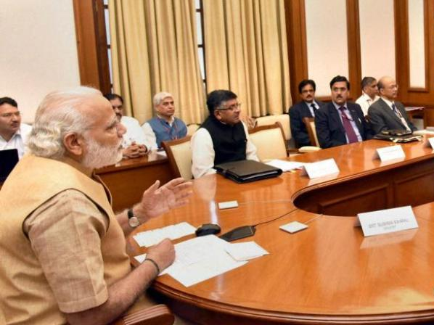
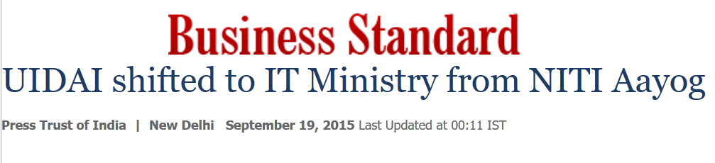
Don’t mix up the Ministries!!
Communication related
Communication
Telecom
Department of Post
TRAI, BSNL etc.
I&B
Prasar Bharti, Press Council of India, Censor Board, FTII, Film-awards
Min. Electronics, Info. tech
NIC, CERT-In, CDAC, SAMEER etc.
UIDAI- attached office
Notes:
http://www.business-standard.com/article/printer-friendly-version?article_id=115091801266_1

Slide 25
Commu.Min ► Telecom: Major PSUs
89 MTNL
Delhi and Mumbai
00 BSNL
Corporatization of DoT
12 BBNL
Bharat Broadband
NOFN- 2.5 lakh gram sabha
Hemisphere properties
VSNL ► disinvestment Tata Comm.
Surplus land went to this PSU .
Notes:
Total 6 PSUs

Slide 26
Telecom Regulation
TRAI’97 Statutory
R.S.Sharma (IAS)
TDSAT’00 Statutory
Telecom (+Cable) dispute settlement and appellate
Chief: retired SC judge
Not bound by CrPC, Appeal ►SC
Telecom Commission ‘89
DoT’s policy and budget
Fair competition & customer protection
Telecom Regulatory Authority of India

Slide 27
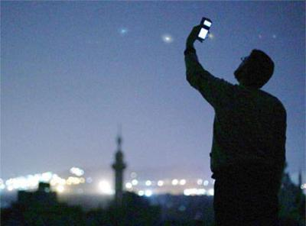
Call Drops: WHY?
Spectrum
Shortage of spectrum in key bands like 900 MHz and 1,800 MHz.
Towers
Shortage of towers, ULB permission, no sharing between companies. Invested too much in spectrum auction.
Laws of physics
Entering no coverage zones such as a basement or lift when a conversation is on, to complex terrains, moving vehicles, the presence of huge waterbodies, flyover and even landlords shutting off power supply
Customer protection
TRAI: compensate customers.
SC: Firms alone can't be blamed for call drops, hence TRAI can't impose penalty.
Notes:
Daily Rs. 1 for every call drop, max..3 call drops.

Slide 28

Single number for all emergencies
TRAI recommends to Telecom Commission
create 112 as a single emergency-response number, on lines of USA’s 911
Phase out 100 (police), 101 (Fire), 108 (Ambulance) and other numbers.

Slide 29
DoT license types
infrastructure providers license
Tower, cables
Right of way (for laying down fibres, Muni. Earn $)
Unified license
Voice services; Data services
Unified license for Virtual network operators
New category, permitted by Telecom Commission
Buy unused capacity from large companies, deliver to last mile.
Interested players: Virgin Mobile, Lyca, Giffgaff etc.
Large cos- stressed balance sheets, can’t roll out despite infra.

Slide 30
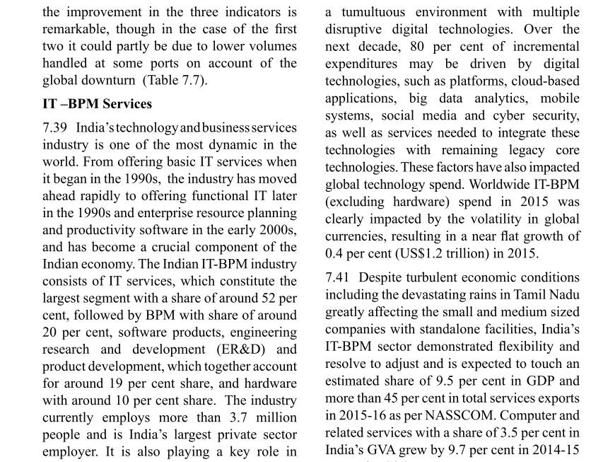
V2c7: Service sector
Mostly Ranking and description of various service-industries
IT, Aviation, Shipping, Tourism ► Mains, interview

Slide 31
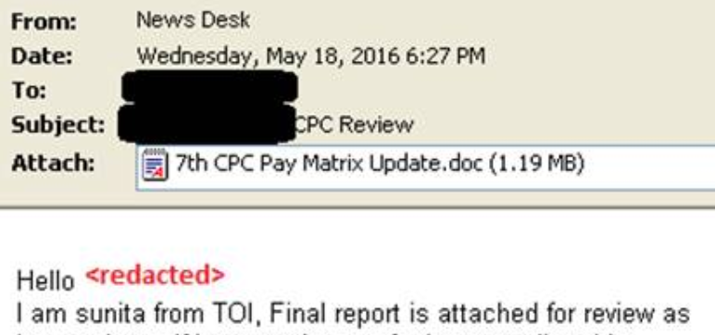
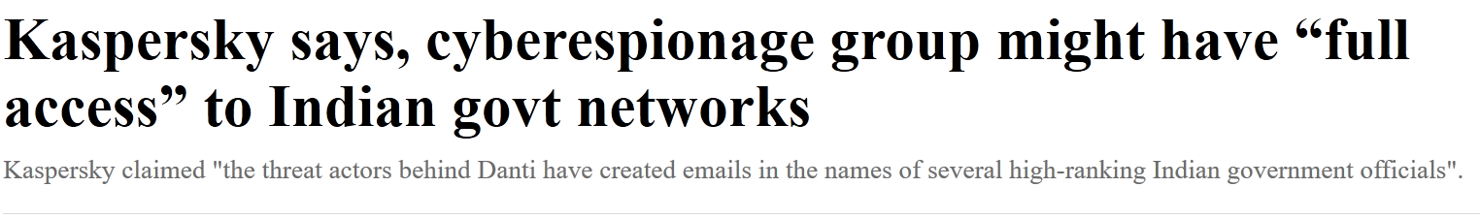
GS3: 7th Pay Commission for cyberespionage
timesofindiaa.in
Sent to defense officers
Breach Remote Administration Tool (BreachRAT).
Uploads user-files to attack server

Slide 32
BES165 Infrastructure ► Communication
Radio (Sci-Tech)
Telecom (YB)
Post office (History & Culture)
Mass Comm. (YB)

Slide 33

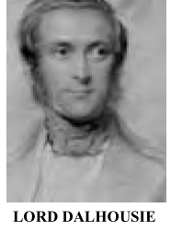
Bahubali Post office: The beginning
1766: Clive started
1774: Hastings expanded
1854: Dalhousie- Post Office Act; 1st postal stamp, rates by wt & not by distance

Slide 34
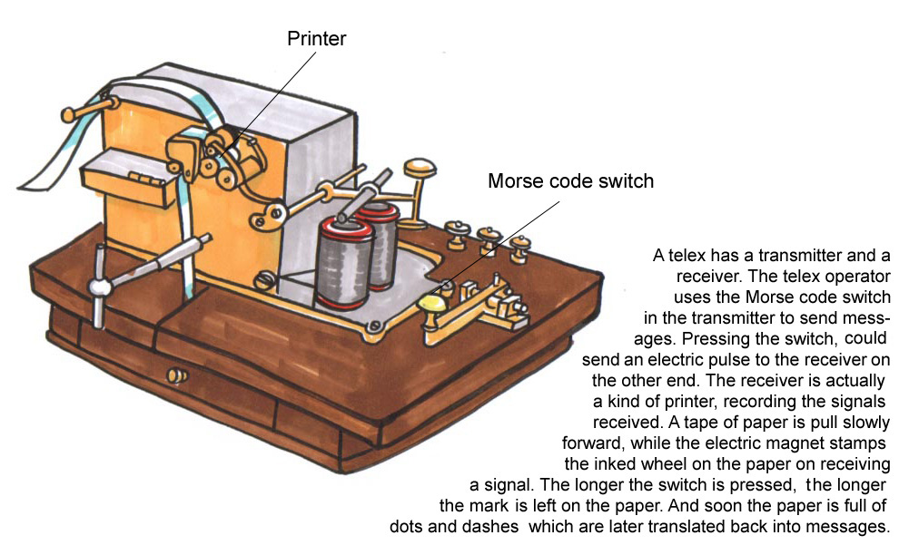
Bahubali Telegram: the Beginning
Who invented?
Germany: Steinheil
India: Lord Dalhousie (1848-1856)
1852: O’Shaughnessy as Superintendent, connect major cities with telegraph – 1854 opened for juntaa.
1857: helped instant communication.
England: Wheatstone
USA: Morse (dots and dashes code)
2013: Stopped by India Post (instead of Morse, it was using Web based system anyways)
1850: experimental Kolkata and Diamond Harbour
Principle: Electricity and Magnetism

Slide 35
Indian Post: yearbook
Who?
Min. communication ► Dept. of Posts
Terms
Project Arrow 2008: corporatization
~1.5 lakh offices
Services/products: ch.8 IYB
Payment Bank BES161/P10
Training?
Rafi Ahmed Kidwai NPA, Ghaziabad
Khilafat to Home minister of UP (‘46); Comm. Min in Nehru Cabinet.
To be started by 2017, March.
Higher executives to 2b imported frm PSB
Start with 50 branches, 5 in NE

Slide 36
Postal insurance
PLI (1884)
Whole Life Assurance (Grama Suraksha)
Convertible Whole Life Assurance (Grama Suvidha)
Endowment Assurance (Grama Santosh)
Anticipated Endowment Assurance (Grama Sumangal)
10 years RPLI (Grama Priya)
Children Policy(Bal Jiwan Bima)
Rural PLI (Malhotra Committee)
Whole Life Assurance (Grama Suraksha)
Convertible Whole Life Assurance (Grama Suvidha)
Endowment Assurance (Grama Santosh)
Anticipated Endowment Assurance (Grama Sumangal)
10 years RPLI (Grama Priya)
Children Policy(Bal Jiwan Bima)

Slide 37


Philately: 2015-16 ► Nabakalebara (Culture)
Year with ‘adhikmas’.
Puri’s Lord Jagannath’s idols replaced.
Idols build with special neem tree.

Slide 38
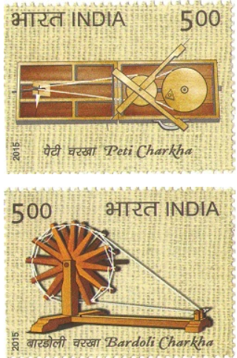
Indra,the tiger Charkha, the spinning wheel
Found in Harappa, Arthshashtra, Marco Polo
1921: Congress started Charkha Sangh
Gandhi used two types-
He designed portable Charkha in Yeravda jail.

Slide 39
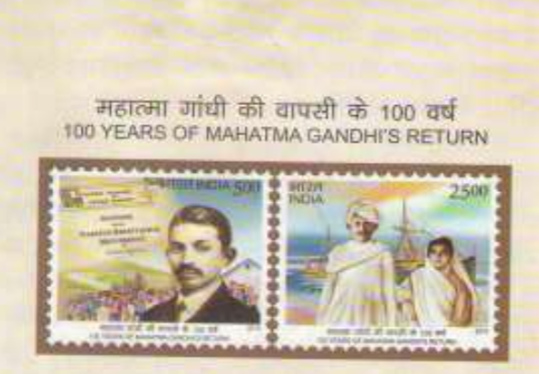
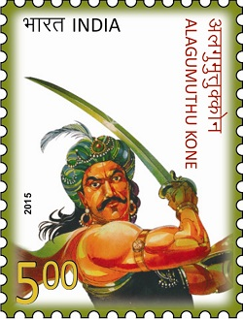
Philately: 2015-16 ► Leaders
Rajendra Chola-I (1000 years of coronation)
Ashok LucentGK/TN class11
Dr. Ambedkar : 125th Anniversary
14thApril 1891
More this article
My Article
9th January 1915, returned from S.Africa
Tuticorin, TN
Fought against British
1710s

Slide 40
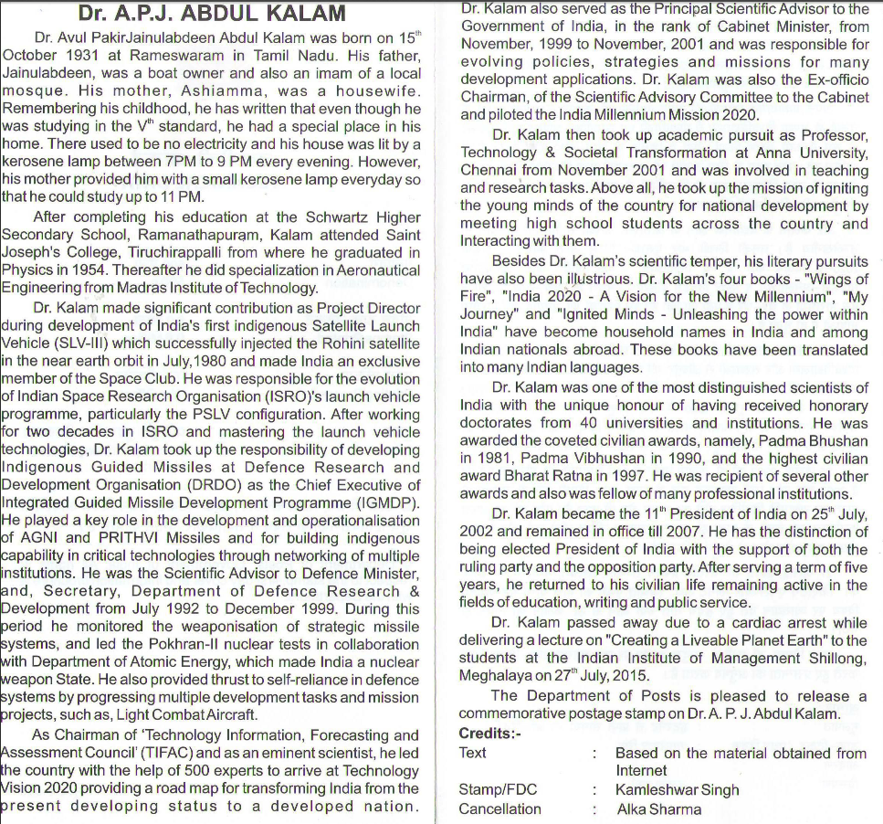


Slide 41
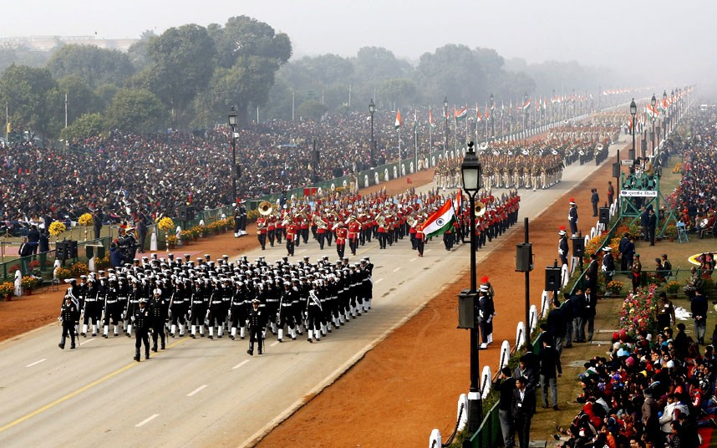
Philately: 2015-16 Defense related
Project Rukmani
ISRO’s GSAT-7 satellites for Navy’s SATCOM
Started in 2013
50 years of 1965 war + BSF
Pak’s Op. Gibraltar to infiltrate J&K: LBS vs. Ayub Khan
1/12/1965 BSF – later Act in 68.
200 years of Gorkha Rifles
1815: fought against East India company.

Slide 42
Philately: 2015-16 org. related
Fire services
1855: Bombay Fire Brigade (Dalhousie's era)
14th April: fire service day.
12th Sch: Fire service under Municipalities, else States
Motto: "WE serve to save"
100 years of ZSI
Zoological survey of India - 1916

Slide 43
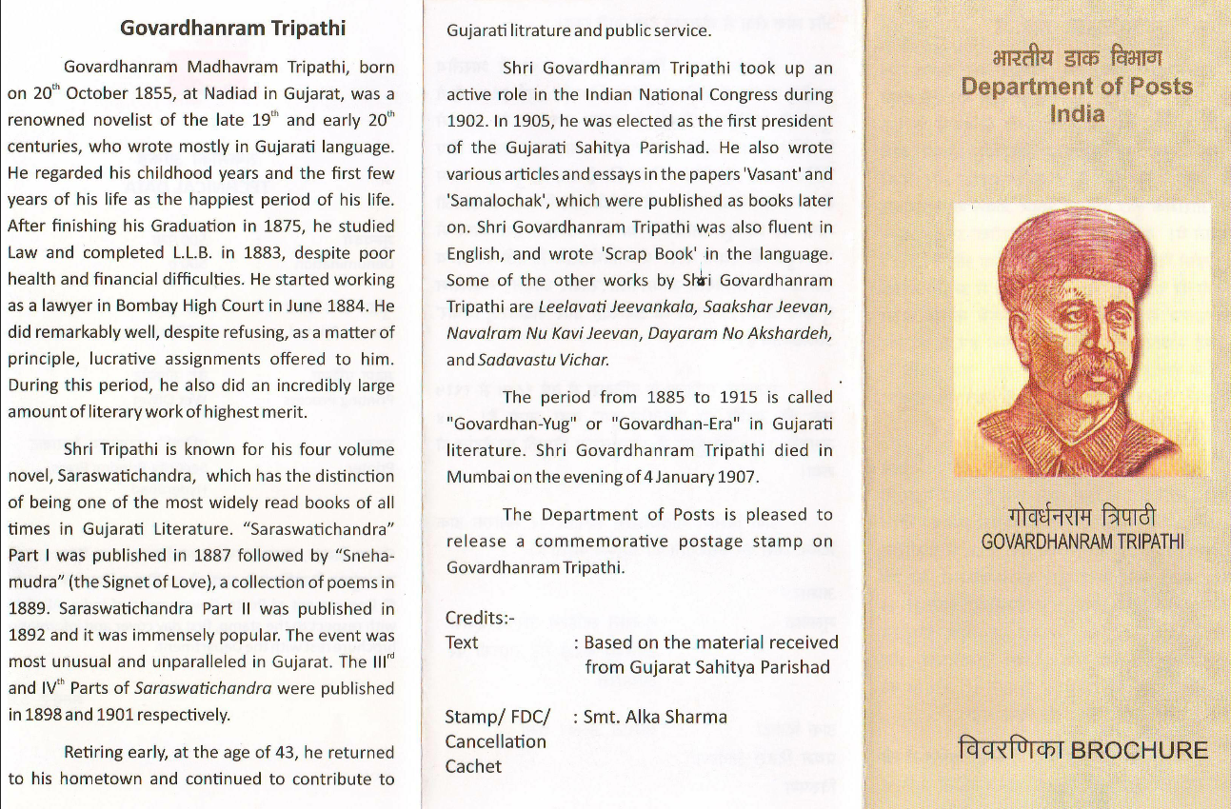
Follow up for interview / literature optional of your state

Slide 44
BES165 Infrastructure ► Communication
Radio (Sci-Tech)
Telecom (YB)
Post office (History & Culture)
Mass Comm. (YB)

Slide 45
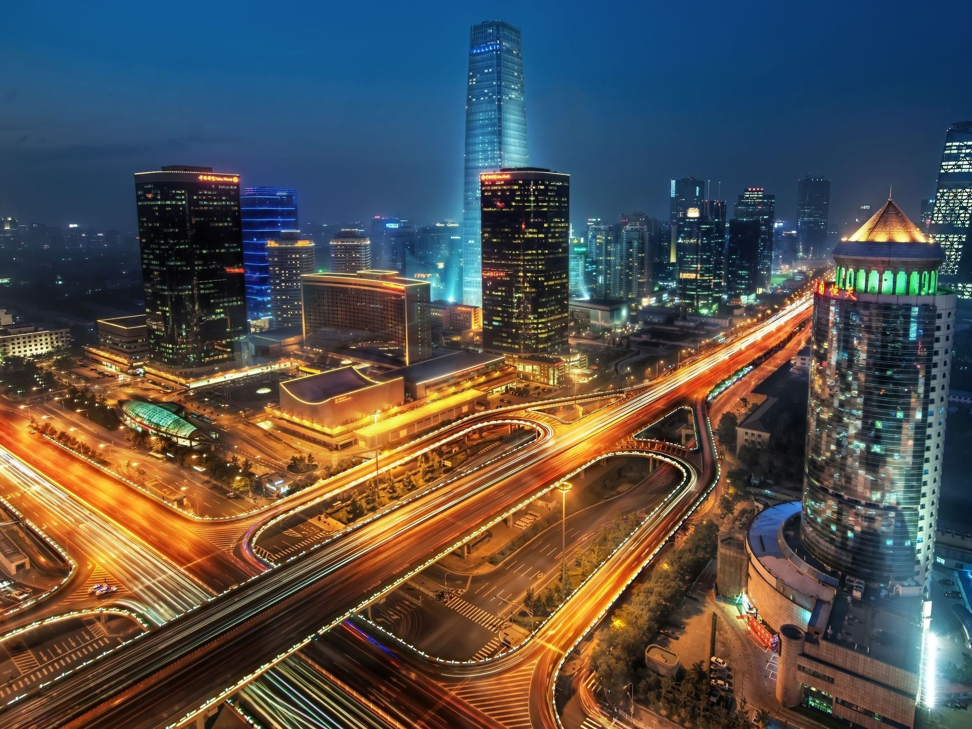
BES165 Infrastructure ► NEXT Transport & urban infra.
Kelkar PPP
Rail Budget
CAP-2016
Road/Ship
Urban infra.

